Slide 1
CSC 362: System Programming
Lecture 10
Original slides by: Amitabha Dey
Adapted by: Dr. Richard Johnson
Department of Computer Science University of North Carolina at Greensboro

Slide 2

Status Check
Advanced Makefile Application
Common Variables, Phony Targets, Pattern Rules, Automatic Variables, Conditional Directives, Recursive Make
What we will cover today
Compilation Stages
Preprocessing, Compiling, Assembling, Linking
Static Linking vs Dynamic Linking
Shared Libraries
Dynamic Linking with
dlopen(), dlsym(), and dlclose()
Shared Library Versioning
Notes:
Lecture Overview:
Lists the day's topics:
Compilation Stages
Static vs. Dynamic Linking
Shared Libraries
Versioning

Slide 3
Compilation Stage Breakdown
Preprocessing
Preprocessing (.i file)
The preprocessor expands macros, handles #include directives, removes comments, and processes conditional compilation commands (e.g., #ifdef).
gcc -E main.c -o main.i
-E: Tells GCC to stop after the preprocessing stage and output the result.
-o main.i: Writes the output to the file main.i.
main.i contains the fully expanded code after preprocessing.
Notes:
Compilation Stage Breakdown - Preprocessing:
Explains that the preprocessor expands macros and handles #include directives to create a .i file.
Preprocessing Flags:
Details gcc –E to stop after preprocessing and -o to name the output expanded code file.
See example: Compilation Process directory

Slide 4
Compilation Stage Breakdown
Compiling
Compiling (.s file)
The compiler takes the preprocessed file and translates the high-level C code into assembly language, which is a low-level, human-readable set of instructions specific to the architecture of the machine.
gcc -S main.i -o main.s
-S: Tells GCC to compile the code but stop after generating assembly, producing a .s file.
-o main.s: Writes the output to the file main.s.
main.s contains the assembly code generated from your C program.
Notes:
Compilation Stage Breakdown - Compiling:
Describes translating high-level C into architecture-specific assembly language in a .s file.
Compiling Flags:
Details gcc -S to generate assembly and -o to specify the output filename.

Slide 5
Compilation Stage Breakdown
Compiling
Are .s and .asm the Same?
Yes, both are assembly source files, but their naming reflects different toolchain traditions:
.s → Unix/GNU style (GCC, AT&T syntax)
.asm → Windows/MS-DOS style (Intel syntax)
Compiling (.s file)
The compiler takes the preprocessed file and translates the high-level C code into assembly language, which is a low-level, human-readable set of instructions specific to the architecture of the machine.
gcc -S main.i -o main.s
-S: Tells GCC to compile the code but stop after generating assembly, producing a .s file.
-o main.s: Writes the output to the file main.s.
main.s contains the assembly code generated from your C program.
Notes:
.s vs .asm Naming:
Clarifies that .s is used for Unix/GNU style (AT&T syntax) and .asm for Windows/MS-DOS style (Intel syntax).

Slide 6
Compilation Stage Breakdown
Assembling
Assembling (.o file)
The assembler converts the assembly code into machine code (also known as object code), which the CPU can understand. This is stored in an object file with a .o extension.
gcc -c main.s -o main.o
objdump -d main.o
-c: Tells GCC to compile and assemble the file, but stop short of linking, creating an object file (.o).
-o main.o: Writes the output to the file main.o.
The object file contains the binary instructions that the CPU understands but is not yet a complete executable
program (because it may need to be linked with other object files or libraries).
-d (disassemble): This option disassembles the machine code in the object file to assembly language instructions.
Notes:
Compilation Stage Breakdown - Assembling:
Explains the assembler's role in converting assembly code into machine-readable object code in a .o file.
Assembling Flags & Objdump:
Details gcc -c for assembly and objdump -d to disassemble machine code back into assembly instructions for viewing .

Slide 7
Compilation Stage Breakdown
Linking
Linking (Executable File)
In the final stage, the linker combines the object file(s) and any necessary libraries into a single executable program.
gcc main.o -o program
main.o: The object file that was generated during the assembly step.
-o program: Specifies the output executable file, named program.
The linker combines the object file(s) and links in any required libraries (like the C standard library libc) to create an executable. The result is a fully functional program that can be executed directly by the operating system.
Notes:
Compilation Stage Breakdown - Linking:
Describes the final stage where object files and libraries are combined into a single executable program.
Linking Flags:
Explains gcc [object_file] -o [program] to create a fully functional executable .

Slide 8
Breakdown of the Flags
E (-E) for Expand (expands macros and includes)
S (-S) for Source (assembly is a low-level source)
C (-c) for Compile (compiles into an object file, but doesn’t link)
L (default) for Link (final step)
"Every Smart Coder Links"
➡ E - Preprocessing (-E)
➡ S - Assembly (-S)
➡ C - Compilation (-c)
➡ L - Linking (default)
gcc -E myfile.c -o myfile.i # Expand (Preprocessing)
gcc -S myfile.i -o myfile.s # Source (Assembly) gcc -c myfile.s -o myfile.o # Compile (Object file) gcc myfile.o -o myfile # Link (Final executable)
Notes:
Summary of Flags (ESCL):
Provides a mnemonic "Every Smart Coder Links" for the flags:
-E (Expand)
-S (Source)
-c (Compile)
default (Link)

Slide 9
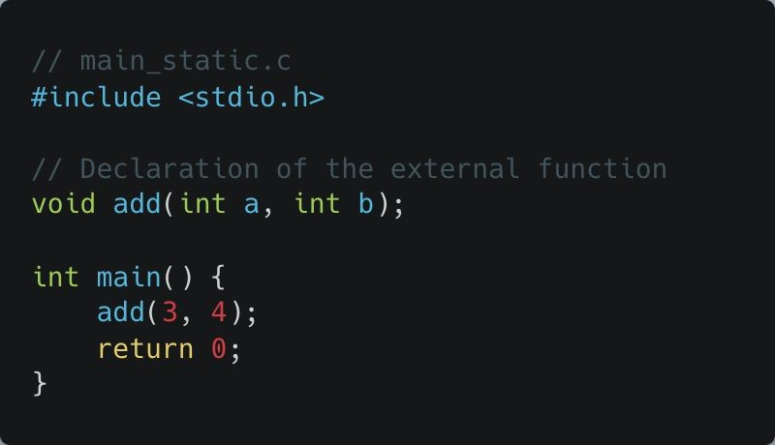
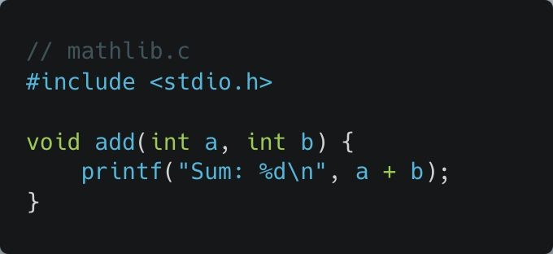
Static Linking
gcc -c mathlib.c -o mathlib.o
gcc -o program_static main_static.c mathlib.o
The linker takes both main_static.o and mathlib.o
and combines them into the executable program_static.
Notes:
Static Linking Commands:
Shows the command gcc -c mathlib.c -o mathlib.o used to begin the static linking process.
Creating a Statically Linked Program:
Demonstrates combining main_static.c and mathlib.o into a single executable program_static .
See example: Static Linking directory

Slide 10
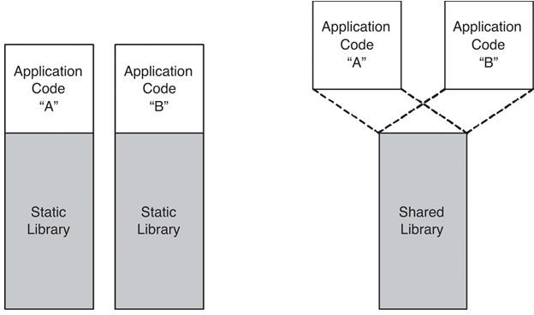
Static Linking vs Dynamic Linking
In static linking, all the necessary libraries are copied into the final executable at compile time. This results in a larger executable but doesn't require the external libraries at runtime.
How Static Linking Works
Collects and links all necessary object code and libraries into one large executable.
Benefits: Fast execution, no external dependencies.
Drawbacks: Larger executable size, no runtime updates.
Image credit - Derek Kwok @ Medium
Notes:
Static vs. Dynamic Overview:
Contrasts how static linking copies libraries into the executable, resulting in larger file sizes but no runtime dependencies.
Pros and Cons of Static Linking:
Lists benefits (fast execution, no dependencies) and drawbacks (large size, no easy updates).

Slide 11
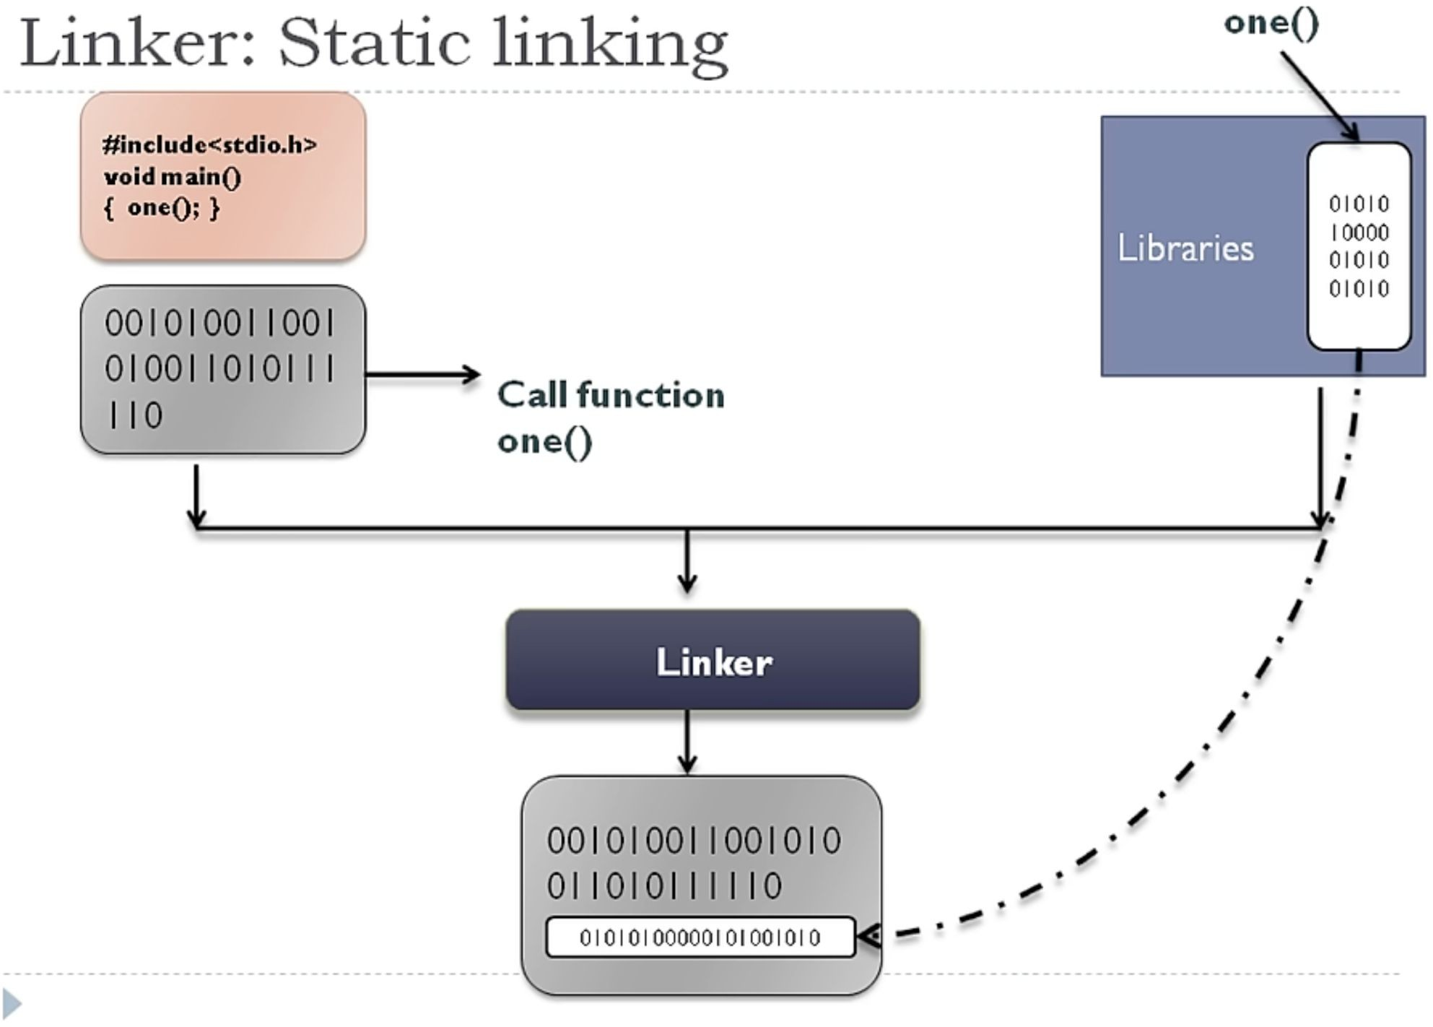
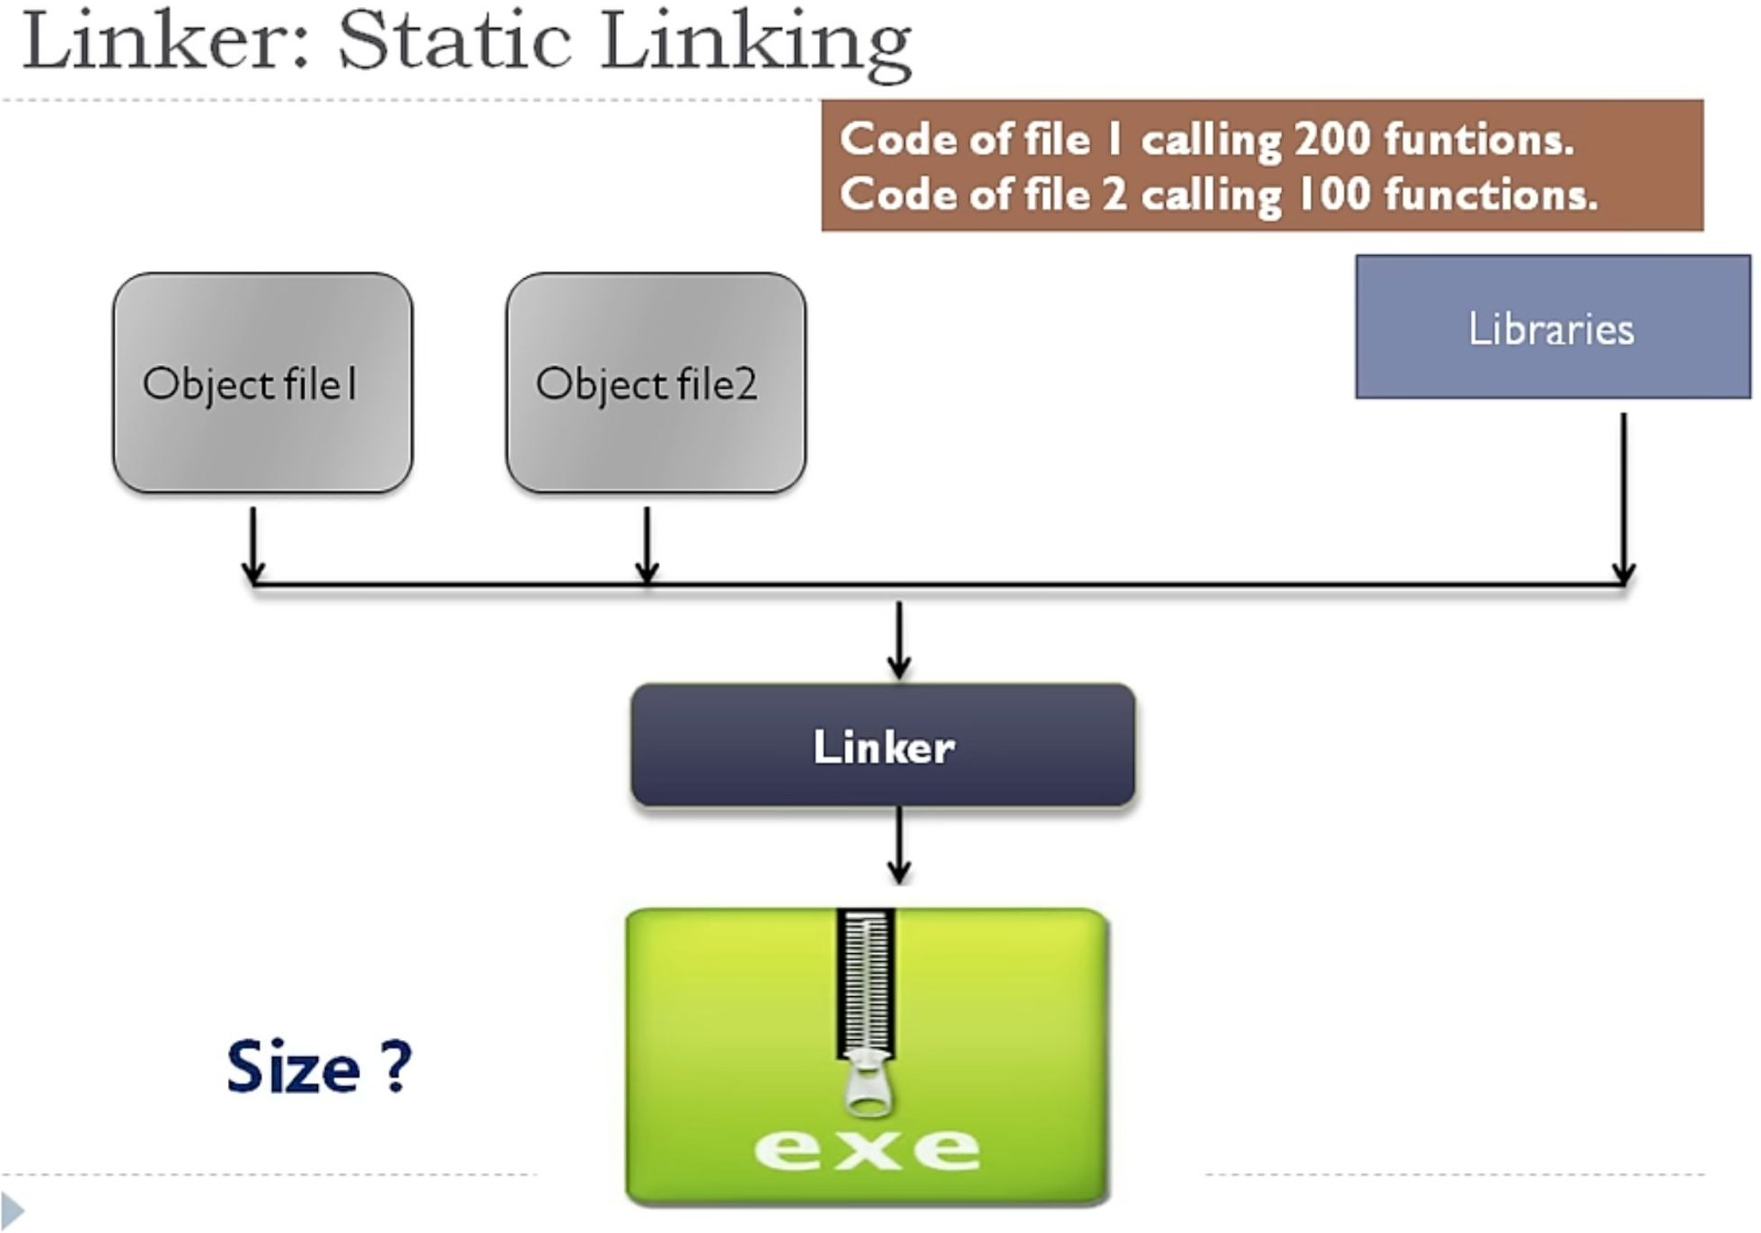
Static Linking
Image credit - HowTo @ YouTube
Notes:
Figure 1:
A diagram of static linking where a linker combines application binary code and library binary code into a single executable.
Figure 2:
A flow chart showing a linker merging two object files and libraries into a single, potentially large .exe file.

Slide 12
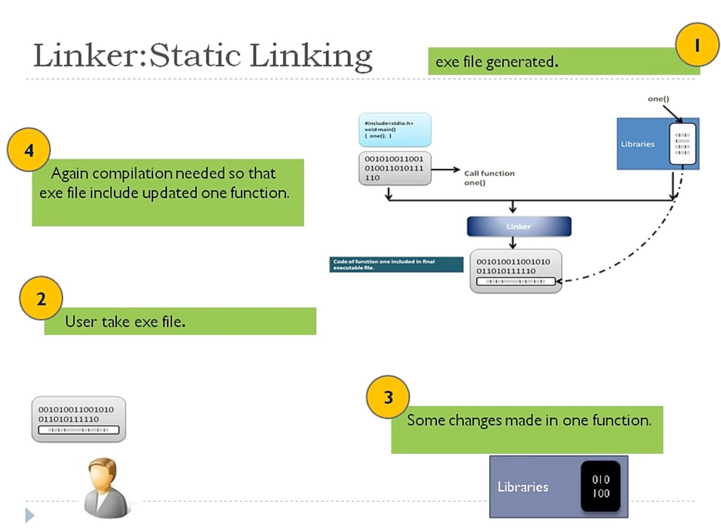
Static Linking
Image credit - HowTo @ YouTube
Notes:
Figure illustrates the drawback of static linking:
A four-step diagram explaining that static linking requires a full re-compilation of the executable if a library function is updated.

Slide 13
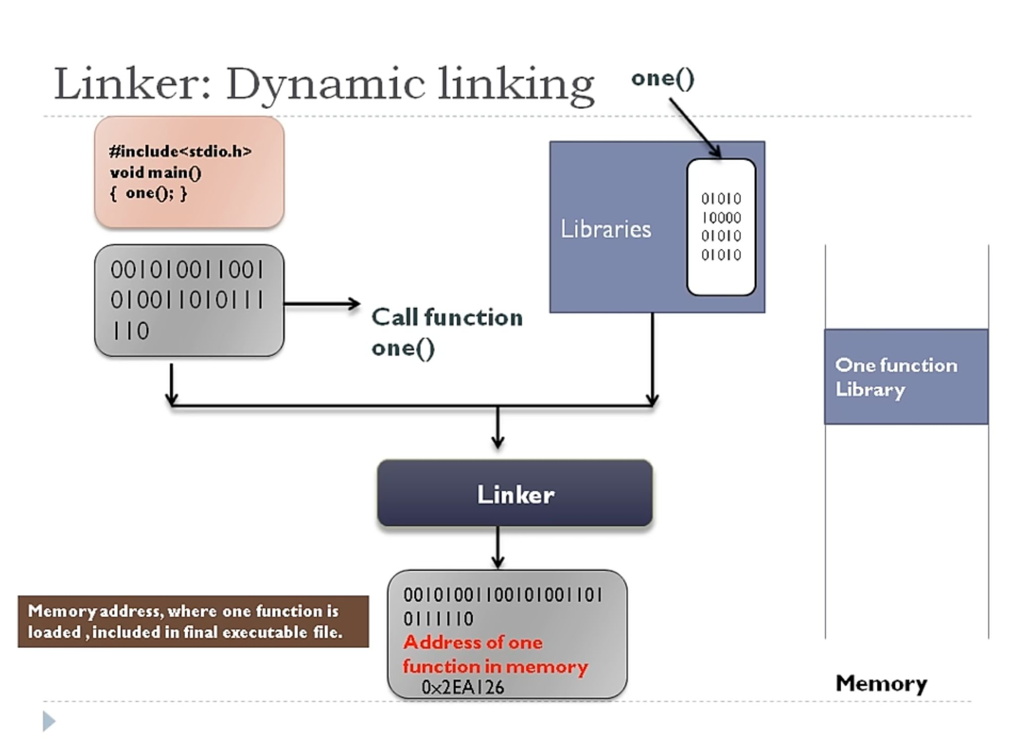
Dynamic Linking
Image credit - HowTo @ YouTube
Notes:
Figure description:
A diagram of dynamic linking where the linker places a memory address reference in the executable instead of the full library code.

Slide 14
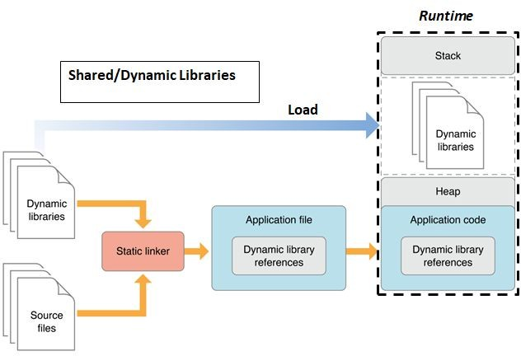
Dynamic Linking
Dynamic linking allows executable programs to use shared libraries at runtime rather than embedding all necessary code directly into the executable. This leads to smaller executables and the ability for multiple programs to share the same library in memory, reducing redundancy.
Steps to Demonstrate Dynamic Linking
Create a Shared Library (.so file)
Use the Shared Library in a Program
Compile and Run the Program with Dynamic Linking
Image credit - https://www.codeinsideout.com/
Notes:
Dynamic Linking Benefits:
Explains that dynamic linking allows for smaller executables and shared memory usage, reducing redundancy.
Steps for Dynamic Linking:
Outlines the three steps: create a .so file, use it in a program, and compile/run.

Slide 15
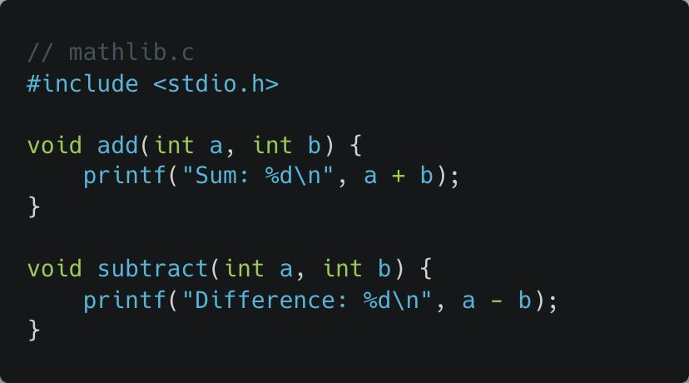
Dynamic Linking
Step 1: Create a Shared Library (.so file)
mathlib.c
Let’s start by creating a shared library. This shared library contains a function that will be dynamically linked at runtime.
A .so file is a Shared Object file.
When a program runs, it doesn’t need to include the entire library in its own executable file.
Instead, it links to a .so file at runtime.
This dynamic linking reduces the size of the executable file and allows multiple programs to share the same library in memory.
Notes:
Step 1:
Shared Library Concept:
Defines .so (Shared Object) files and explains how they are linked only at runtime.
See example: Dynamic Linking directory

Slide 16
Dynamic Linking
Step 1: Create a Shared Library (.so file)
To create a shared library (.so file), use the following command:
gcc -shared -fPIC -o libmath.so mathlib.c
-shared: This tells GCC to generate a shared object file (.so), which can be dynamically linked at runtime.
-fPIC: Generates Position Independent Code (PIC), which is required for shared libraries because they may be loaded at different memory addresses by different programs.
This creates the shared library libmath.so.
Notes:
Creating the Shared Library:
Details the command gcc -shared -fPIC -o libmath.so mathlib.c

Slide 17
Dynamic Linking
Step 1: Create a Shared Library (.so file)
Why is -fPIC Needed?
When a shared library is loaded by different programs, the memory location where it gets loaded is not fixed. To allow the library to work regardless of where it's loaded, all addresses inside it must be relative instead of absolute.
Without -fPIC, the code might contain absolute addresses, which require relocation at runtime, leading to inefficiencies like:
Increased memory usage due to
copy-on-write (COW) being broken.
Potential performance penalties in loading time.
To create a shared library (.so file), use the following command:
gcc -shared -fPIC -o libmath.so mathlib.c
-shared: This tells GCC to generate a shared object file (.so), which can be dynamically linked at runtime.
-fPIC: Generates Position Independent Code (PIC), which is required for shared libraries because they may be loaded at different memory addresses by different programs.
This creates the shared library libmath.so.
Notes:
Importance of -fPIC:
Explains that Position Independent Code (PIC) is necessary because shared libraries are loaded at non-fixed memory addresses.

Slide 18
Dynamic Linking
Step 1: Create a Shared Library (.so file)
To create a shared library (.so file), use the following command:
How Does -fPIC Work?
It ensures that global symbols (functions, variables, etc.) are accessed relative to a base register (usually the Global Offset Table, GOT).
When the library is loaded at runtime, the loader fixes only one base address rather than modifying multiple absolute addresses.
gcc -shared -fPIC -o libmath.so mathlib.c
-shared: This tells GCC to generate a shared object file (.so), which can be dynamically linked at runtime.
-fPIC: Generates Position Independent Code (PIC), which is required for shared libraries because they may be loaded at different memory addresses by different programs.
This creates the shared library libmath.so.
Notes:
How -fPIC Works:
Explains the use of a Global Offset Table (GOT) to access symbols relative to a base register at runtime.

Slide 19
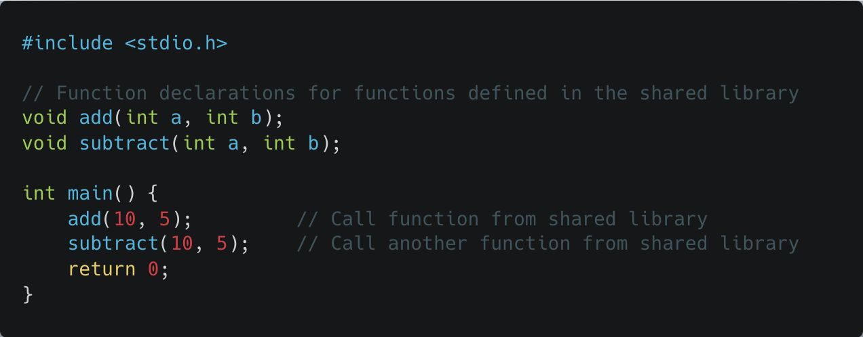
Dynamic Linking Step 2: Use the Shared Library in a Program
main.c
Now, let's create a main
program that will use the shared library libmath.so at runtime.
We declare the functions add and subtract, which are defined in libmath.so, and call them in the main() function.
Notes:
Step 2:
Using the Shared Library:
Shows the main.c code declaring the library functions for use in the main program.

Slide 20
Dynamic Linking
Step 3: Compile and Run the Program with Dynamic Linking
Now we will compile the program main.c but
dynamically link it to the shared library libmath.so:
gcc -o program main.c -L. -lmath
-L.: This tells the linker to look for libraries in the current directory (.).
-lmath: This tells the linker to link against the shared library libmath.so (by convention, lib is dropped, and so is inferred from the -l flag).
When you run this, the executable will be dynamically linked to libmath.so. The shared library libmath.so must be available at runtime for the program to execute properly.
Notes:
Step 3:
Linking the Shared Library:
Demonstrates the command gcc main.c -L. -lmath -o program.
-L.: Look in the current directory for libraries.
-lmath: Link against libmath.so (the lib prefix and .so suffix are assumed).

Slide 21
Dynamic Linking
Step 3: Compile and Run the Program with Dynamic Linking
Now we will compile the program main.c but
dynamically link it to the shared library libmath.so:
If the shared library is located in a different directory, say
/usr/local/mylibs, you specify the path using -L:
gcc -o program main.c -L. -lmath
gcc -o program main.c -L/usr/local/mylibs -lmath
-L.: This tells the linker to look for libraries in the current directory (.).
-lmath: This tells the linker to link against the shared library libmath.so (by convention, lib is dropped, and so is inferred from the -l flag).
When you run this, the executable will be dynamically linked to libmath.so. The shared library libmath.so must be available at runtime for the program to execute properly.

Slide 22
Dynamic Linking
Step 3: Compile and Run the Program with Dynamic Linking
Now we will compile the program main.c but
dynamically link it to the shared library libmath.so:
If libutil.so is in the current directory (.)
gcc -o program main.c -L. -lmath
gcc -o program main.c -L. -lutil
-L.: This tells the linker to look for libraries in the current directory (.).
-lmath: This tells the linker to link against the shared library libmath.so (by convention, lib is dropped, and so is inferred from the -l flag).
When you run this, the executable will be dynamically linked to libmath.so. The shared library libmath.so must be available at runtime for the program to execute properly.

Slide 23
Manual Runtime Linking dlopen(), dlsym(), and dlclose()
-ldl: Links the program with the dynamic linking library, libdl, which provides the functions dlopen, dlsym, and dlclose.
dlopen(): Loads the shared library.
dlsym(): Retrieves the function from the shared library.
dlclose(): Closes the library and frees the resources.
While shared libraries are generally linked automatically by the dynamic linker, you can manually load, access, and unload shared libraries at runtime using the dlopen, dlsym, and dlclose functions from <dlfcn.h>.
This offers flexibility to load libraries only when needed or based on program input, allowing modular and extensible applications.
Notes:
dlopen():
The function used to load a library. It takes a path to a .so file and returns a "handle" (a pointer) to that library.
dlsym():
The function used to find a specific symbol (like a function name) inside the loaded library. It returns a function pointer that your code can call.
dlerror() and dlclose():
dlerror() provides a human-readable string explaining why a load failed;
dlclose() unloads the library to free up memory.
The <dlfcn.h> Header:
Introduces the API for manual loading. Note: You must link with -ldl to use these functions.
See example: Manual Runtime Link directory

Slide 24
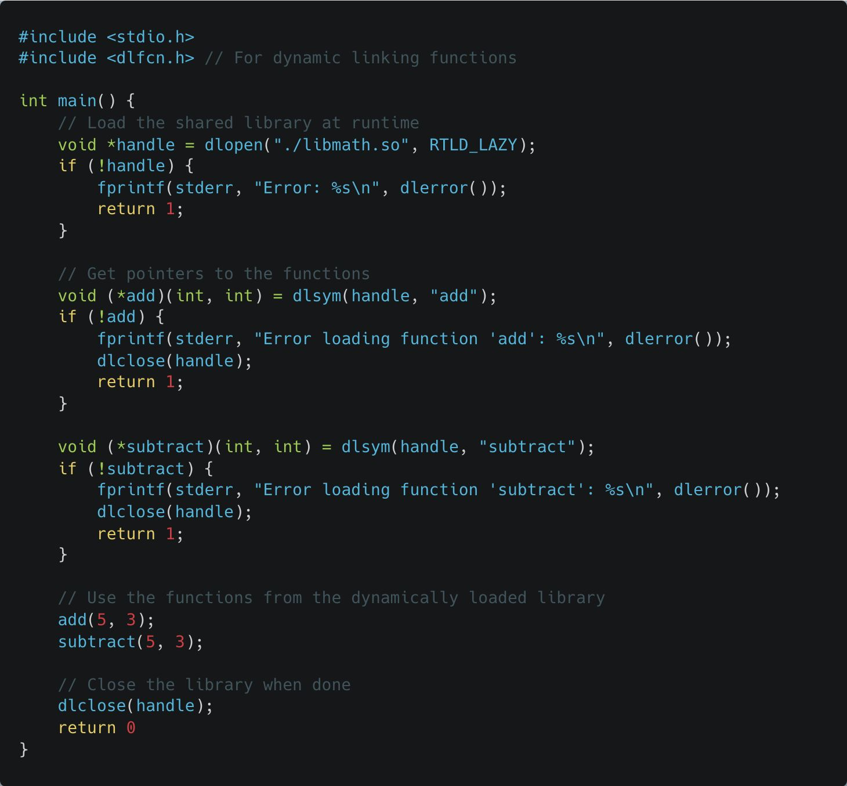

Manual Runtime Linking
dlopen(), dlsym(), and dlclose()
gcc -shared -fPIC -o libmath.so mathlib.c
gcc -o program_dynamic main_dynamic.c -ldl
Notes:
Example Code (dlopen):
A code snippet showing the full workflow: loading libmath.so, finding the add function, calling it, and closing the library.

Slide 25
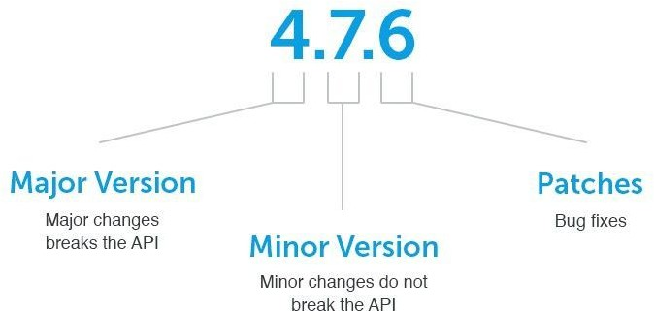
Shared Library Versioning
When you create shared libraries (.so files), it's common to release different versions over time. You might update the library to fix bugs, add features, or optimize performance.
Shared library versioning allows different programs to use different versions of the same library without conflicts.
Symbolic links (symlinks) are used to point to the correct version of the library dynamically, so you can update or switch versions without recompiling the program.
Image credit - https://kodein.hashnode.dev/
Notes:
Semantic Versioning:
Introduces the MAJOR.MINOR.PATCH standard.
Major Versions:
Breaking changes. If the function parameters change, you increment the Major version (e.g., 1.0 to 2.0).
Minor Versions:
New features. If you add a new function but keep the old ones the same, you increment the Minor version.
Patch Versions:
Bug fixes. No changes to the interface, just fixing the logic inside.

Slide 26
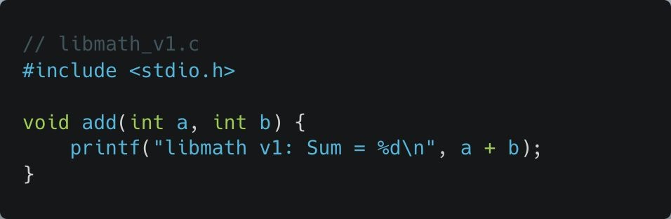
Shared Library Versioning
gcc -shared -fPIC -o libmath.so.1.0 libmath_v1.c
This creates version 1.0 of the shared library libmath.so.1.0.
Notes:
Versioning Walkthrough:
A step-by-step example of creating libmath_v1.c and libmath_v2.c and using symlinks to switch between them.
See example: Shared Library Versioning directory

Slide 27
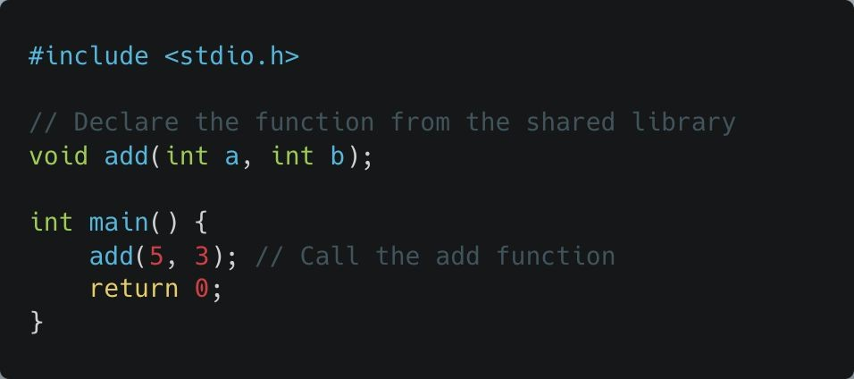
Shared Library Versioning
main.c
-L.: This tells the compiler to look for the library in the current directory.
-lmath: This links against libmath.so, but we haven't created that yet, which is where symlinks come into play.
gcc -o program main.c -L. -lmath

Slide 28

Shared Library Versioning
gcc -shared -fPIC -o libmath.so.2.0 libmath_v2.c
This creates version 2.0 of the shared library libmath.so.2.0.

Slide 29
Shared Library Versioning
Create Symlinks for Versioning
ln -sf libmath.so.1.0 libmath.so
ln -sf: Creates a symbolic link (-s) and forcefully replaces any existing link (-f).
libmath.so: The name of the symlink.
libmath.so.1.0: The actual file to which the symlink points (version 1.0 of the library).
At this point, libmath.so points to libmath.so.1.0.
Update the Symlink
ln -sf libmath.so.2.0 libmath.so
Now libmath.so points to libmath.so.2.0.

Slide 30
Why Is This Different From Recompiling?
In dynamic linking, When a shared library is updated, we typically just replace the .so file (or change a symbolic link to point to a new version), and all executables using that library automatically use the new version without recompilation.
The executable dynamically loads the new version of the library at runtime, the executable remains unchanged.
Once the shared library is updated, all programs using it benefit instantly, whereas in static linking, each executable has to be manually recompiled and replaced.
When a statically linked library is updated, any
executable that uses that library must be recompiled and re-linked to incorporate the new version.
This means creating a new executable file that now includes the updated library code.
If file.a changes, we must rerun the compilation for
my_program to use the new library version.
Need to rebuild and redistribute executables, making updates much less efficient.

